Slide 1

Topic 6
Strings and Conditions

Slide 2
What is a String?

Slide 3
String
A String is a group of characters. Lets look at the following example:
public static void main(String[] args) {
String game = "Super Mario World";
}

Slide 4

public static void main(String[] args) {
String game = "Super Mario World";
}
DATA
S
u
p
e
r
M
a
r
i
o
W
o
r
l
d
\0
INDEX
0
1
2
3
4
5
6
7
8
9
10
11
12
13
14
15
16
17
Keep in mind two things:
We start counting positions at 0. Character ‘S’ in stored at index 0.
To indicate that a String ends, Java stores a NULL character (\0) at the end of the character chain.

Slide 5
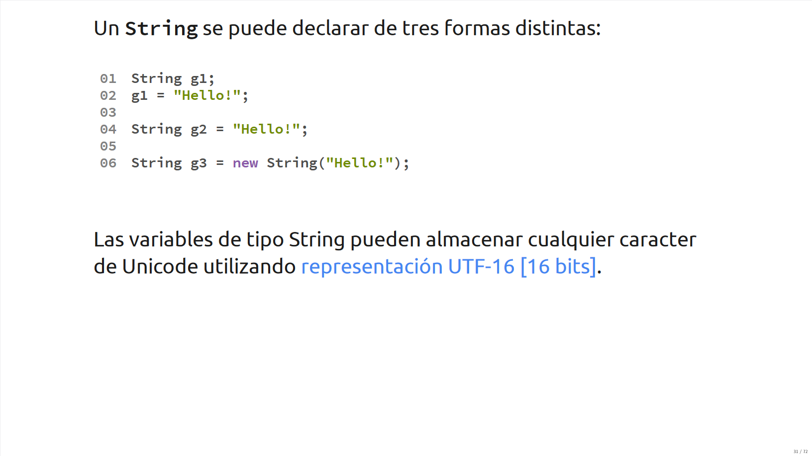

Slide 6
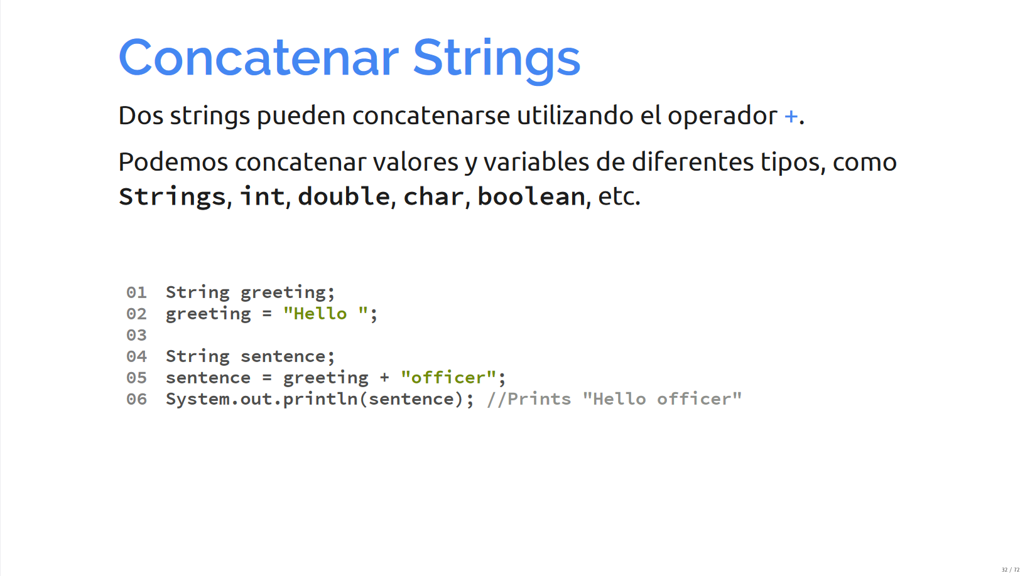
String concatenation
Two strings can be concatenated using the addition operator (+).
We can concatenate different data types together in this way (Strings, ints, doubles, chars).

Slide 7
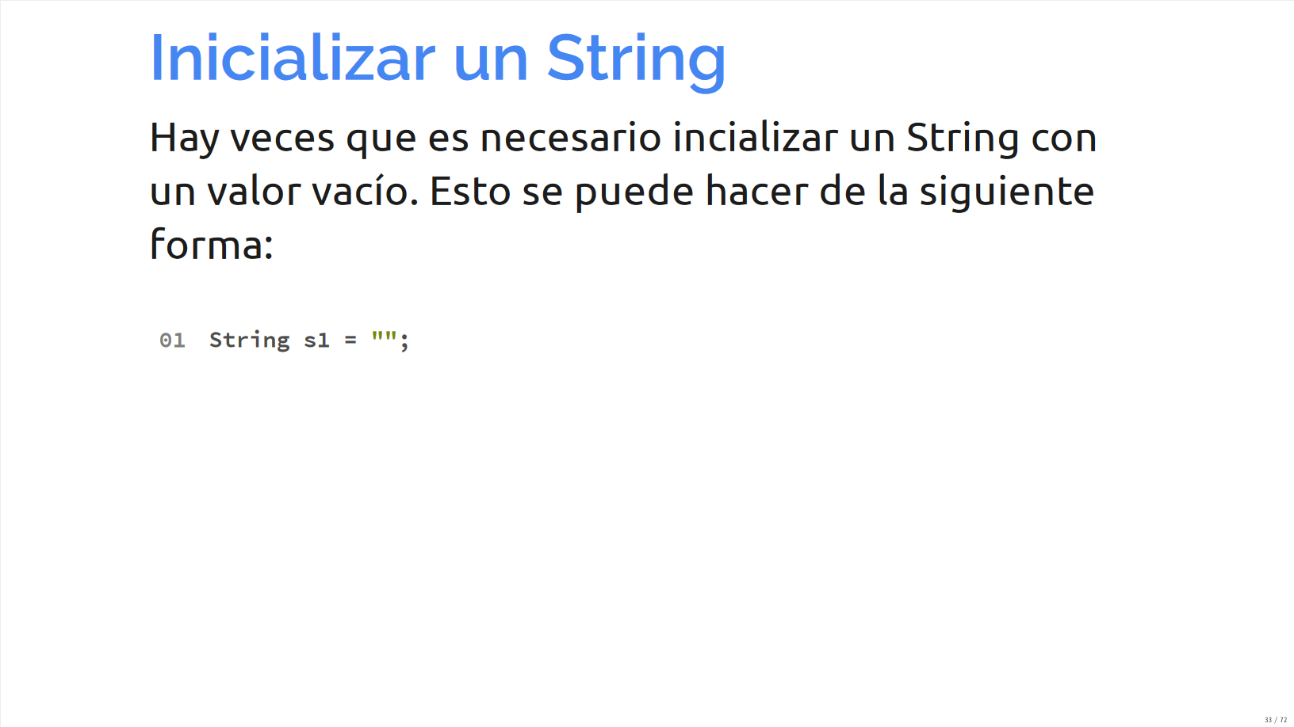
Iniatilize String
We can initialize an empty String using the following statement.

Slide 8
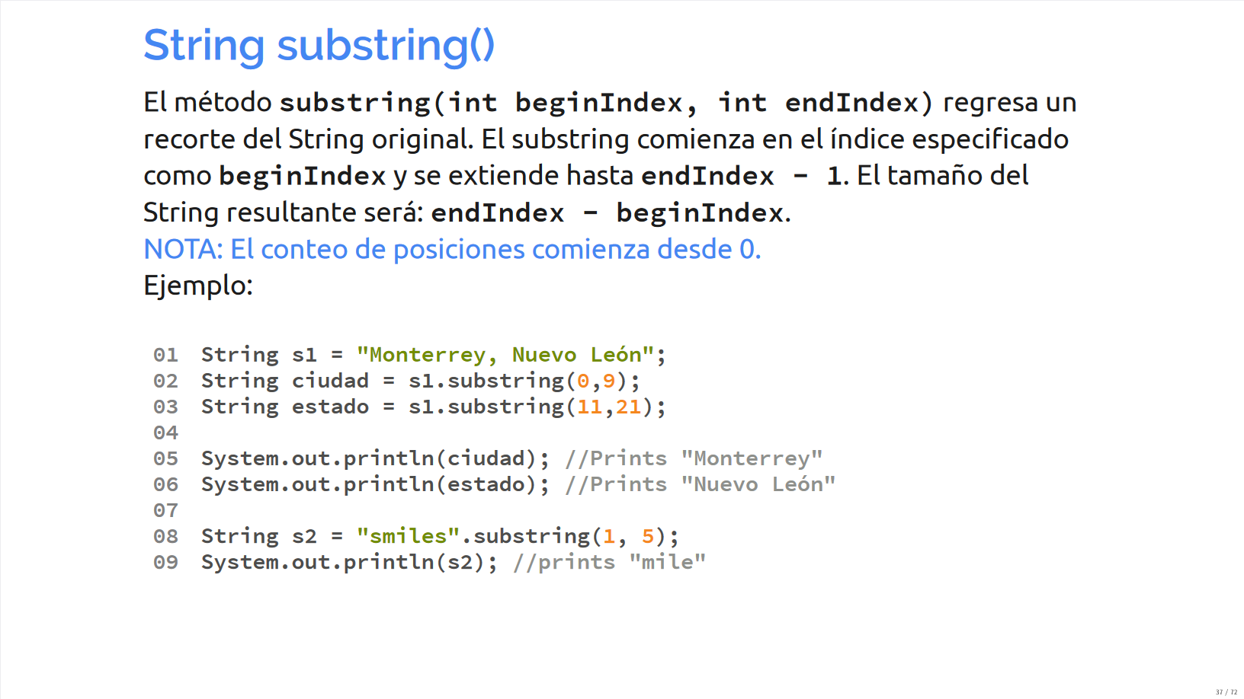
substring() method
The substring(int beginIndex, int endIndex) method returns a smaller set of a given original String.
The substring will begin in the given specified index (beginIndex) and will extend until (endIndex – 1).
The size of the resulting string will be endIndex - beginIndex

Slide 9
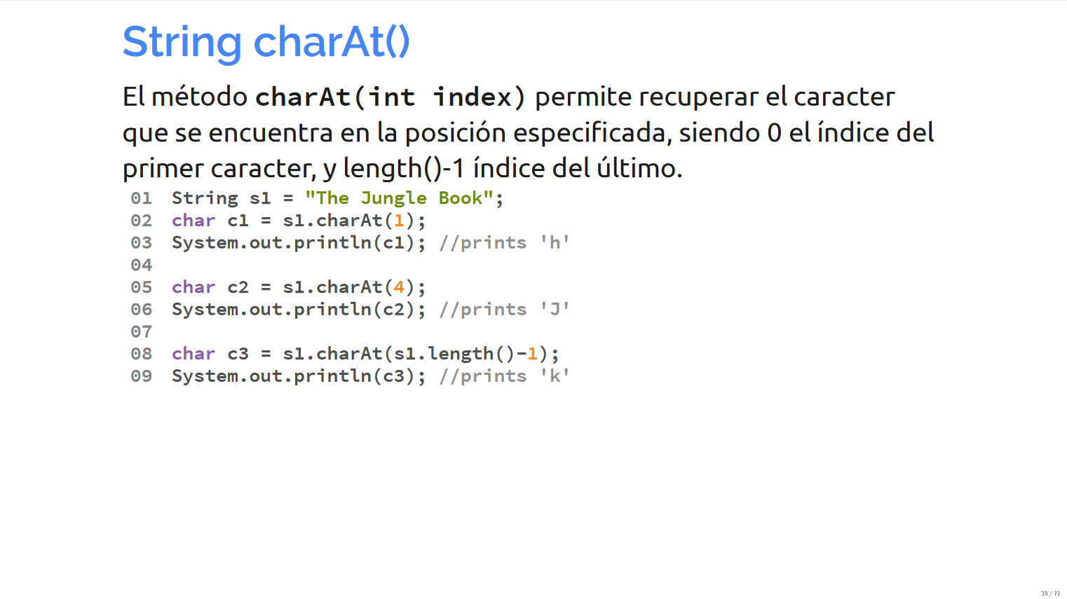
charAt() method
The charAt(int index) method allows you to retrieve the character at the given specified position.

Slide 10
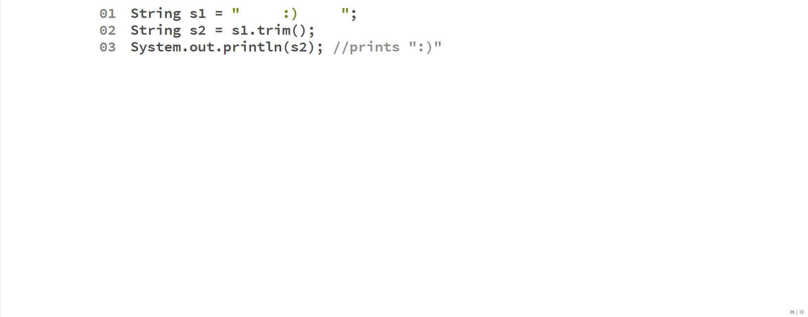
trim() method
The trim() method creates a new string without the empty blank spaces at the beginning and the end of the String.

Slide 11
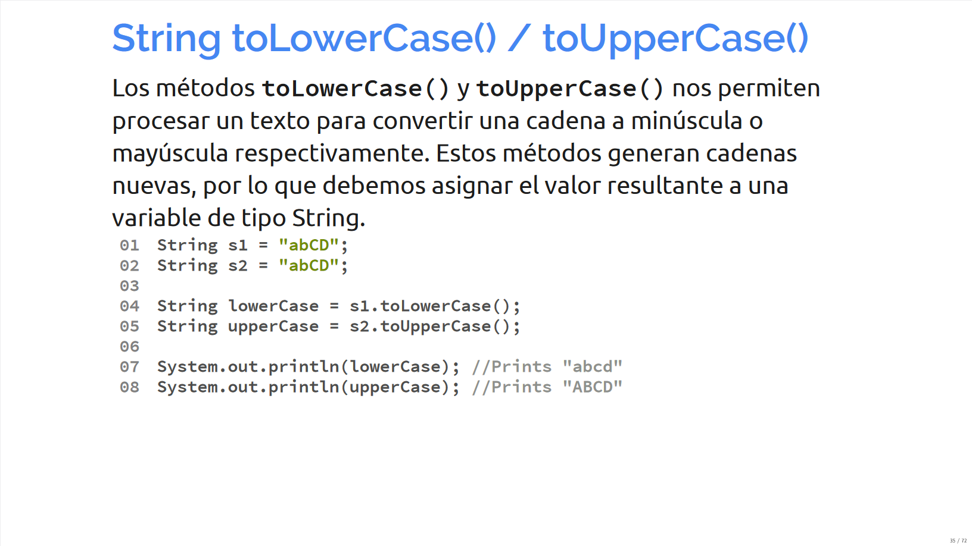
toLowerCase() and toUpperCase() method
Methods toLowerCase() and toUpperCase() allow us to convert a given String into upper or lowercase respectively. This methods create new Strings, so we usually assign their result to a new String variable.

Slide 12
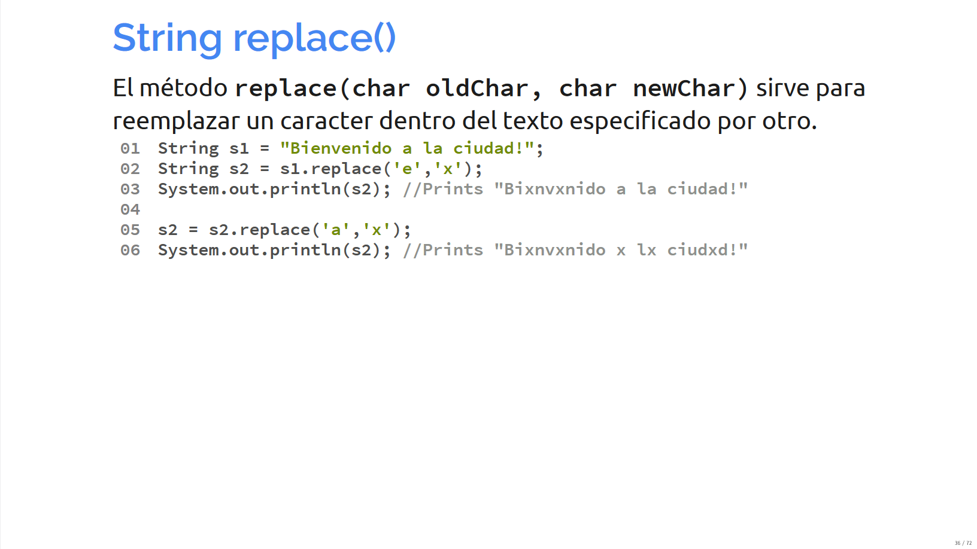
replace() method
The replace() method allows you to replace a character inside of a given text for another.

Slide 13
Conditions

Slide 14
IF
The if statement is a flow control instruction that allows some statements to be executed selectively.
When the boolean expression inside of the if statement evaluates true, then the instructions inside of the block { } will execute.
int numerator = 10;
int denominator = 2;
int result;
if (denominator != 0){
result = numerator / denominator;
}

Slide 15
IF-ELSE
The if block can be paired with an else, which will only be executed when the boolean expression evaluates as false.
int numerator = 5;
int denominator = 0;
int result;
if (denominator != 0){
result = numerator / denominator;
} else {
System.out.println("Error, you cannot divide by zero");
}

Slide 16
Boolean Expression
Inside of an if statement, we put a boolean expression. This can be a simple boolean expression:
if (minutes > 60){
hour++;
}
if (letter == 'c') {
System.out.println("You selected option c");
}
Or complex boolean expressions, which are made up of more than one condition
if ((hour >= 8) && (hour <= 22)){
System.out.println("The store is open!");
}
if (letter == 'a' || letter == 'e' || letter == 'i' || letter == 'o' || letter == 'u' ){
System.out.println("Letter is a vocal!");
}

Slide 17
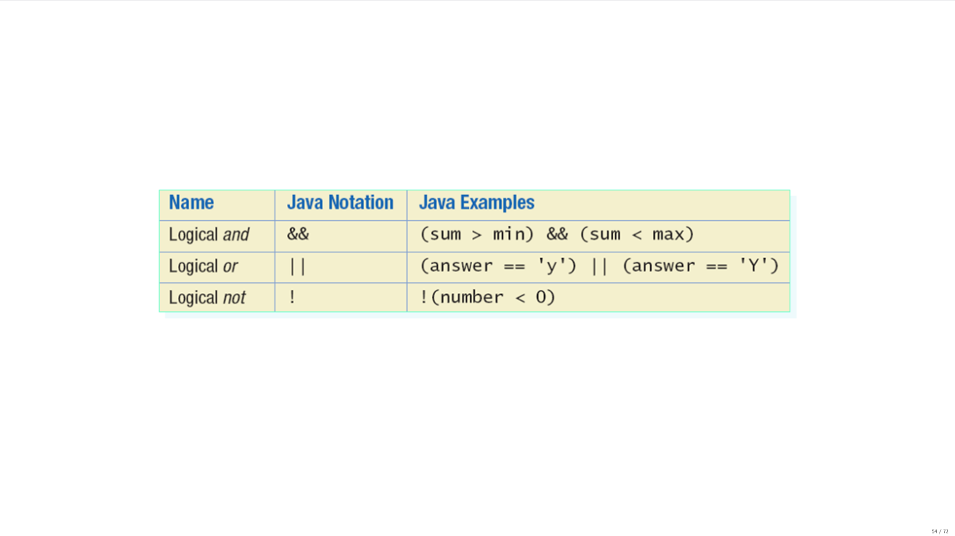

Slide 18
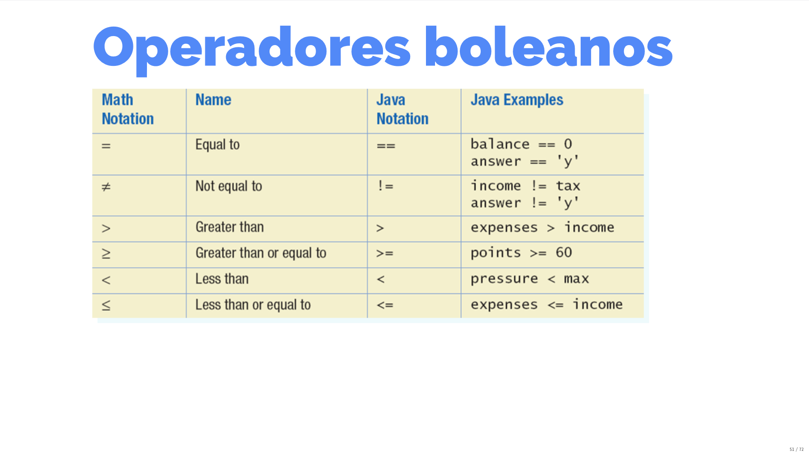

Slide 19
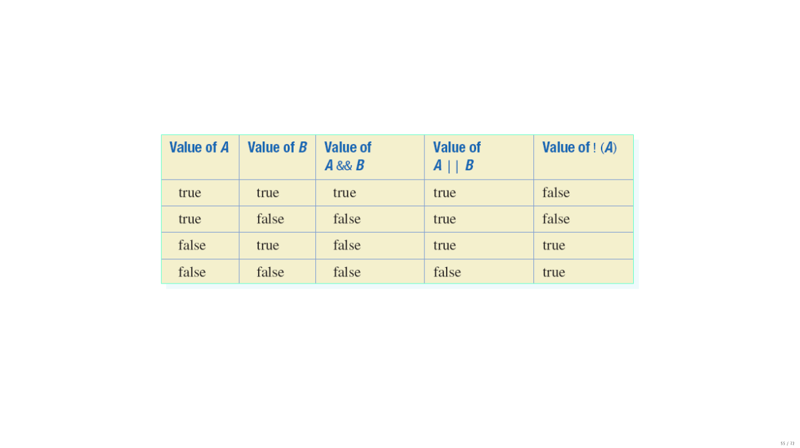

Slide 20
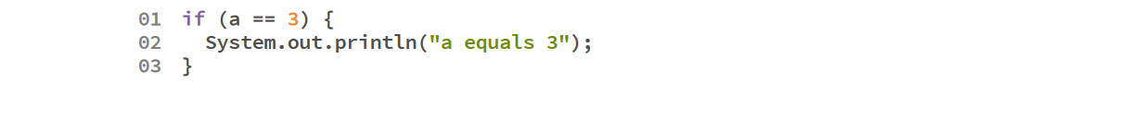
Comparing primitive variables
To compare two primitive variables, we can use the equality operator (==).
For example:

Slide 21
Comparing Strings
Strings, on the other hand, are not primitive variables and can only be compared using the equals() method.
For example:
String s1 = "hello";
String s2 = "goodbye";
if (s1.equals(s2)){
System.out.println("The strings are equal");
} else{
System.out.println("The strings are different");
}

Slide 22
Comparing Strings
Imagine the following Strings s1 and s2. Can you think of a way to test if they are equal without considering lower and upper cases?
String s1 = "hello";
String s2 = "HELLO";

Slide 23
Option 1
We can compare two Strings using the equalsIgnoreCase():
String s1 = "hello";
String s2 = "HELLO";
if (s1.equalsIgnoreCase(s2)){
System.out.println("The strings are equal");
} else{
System.out.println("The strings are different");
}

Slide 24
Option 2
Convert both strings to upper case / lower case, then compare them using the equals() method:
String s1 = "hello";
String s2 = "HELLO";
s1 = s1.toLowerCase();
s2 = s2.toLowerCase();
if (s1.equals(s2)){
System.out.println("The strings are equal");
} else{
System.out.println("The strings are different");
}

Slide 25
Excercise!

Slide 26
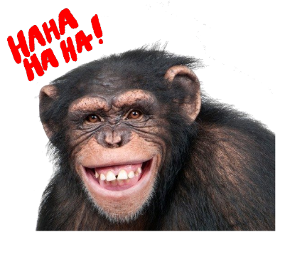
Monkey Trouble
There are two monkeys in a cage. We are in trouble if:
Both monkeys are smiling
None of the monkeys are smiling
Design a Java program to model this interaction

Slide 27
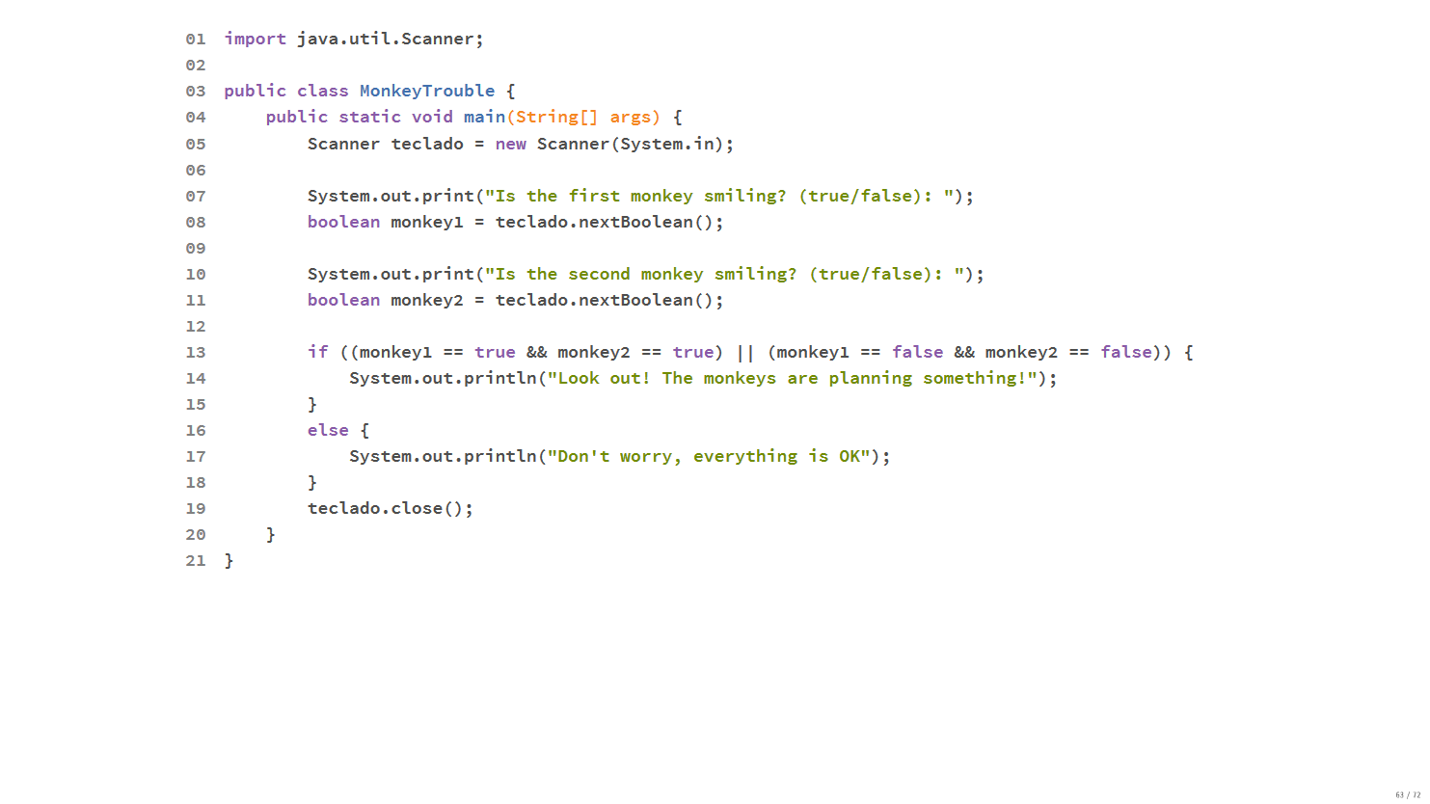

Slide 28
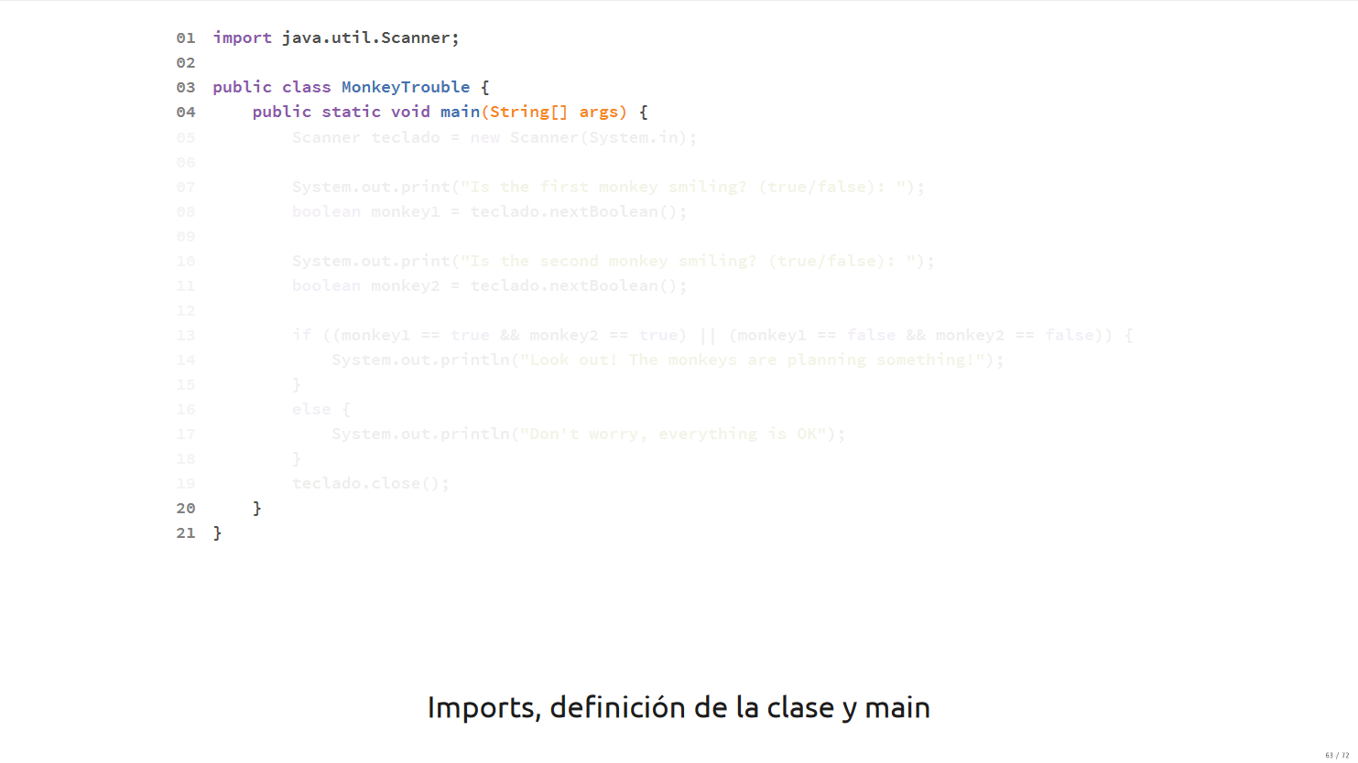

Slide 29
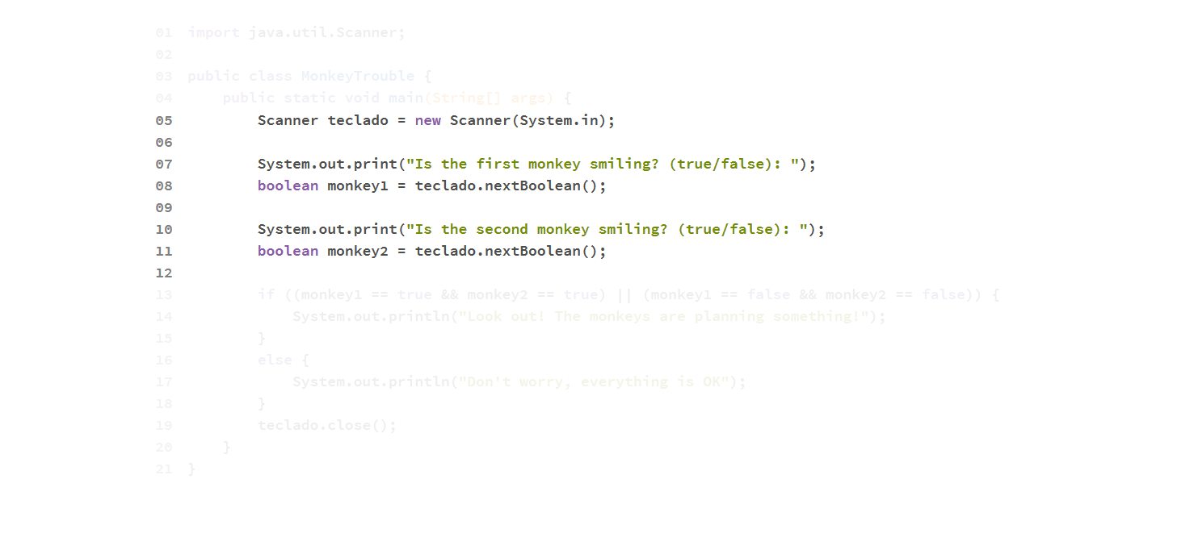

Slide 30
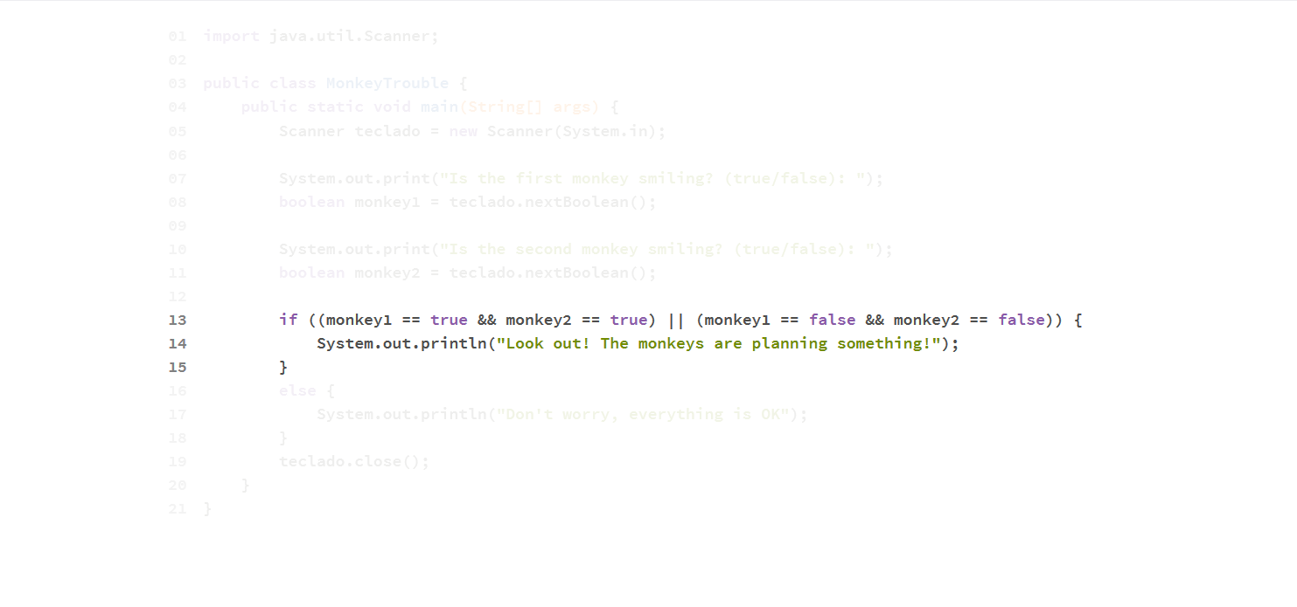

Slide 31
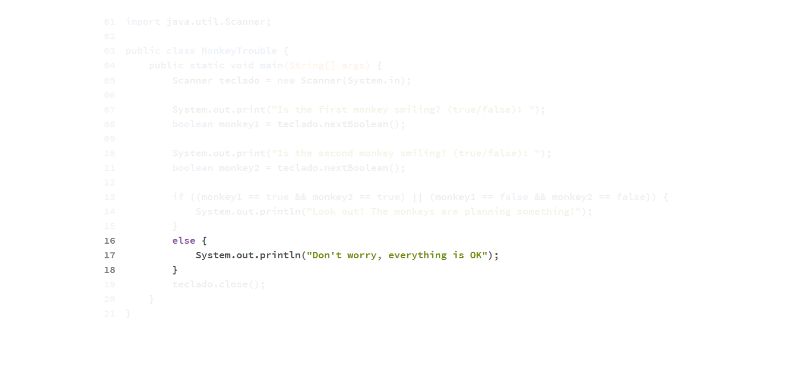

Slide 32
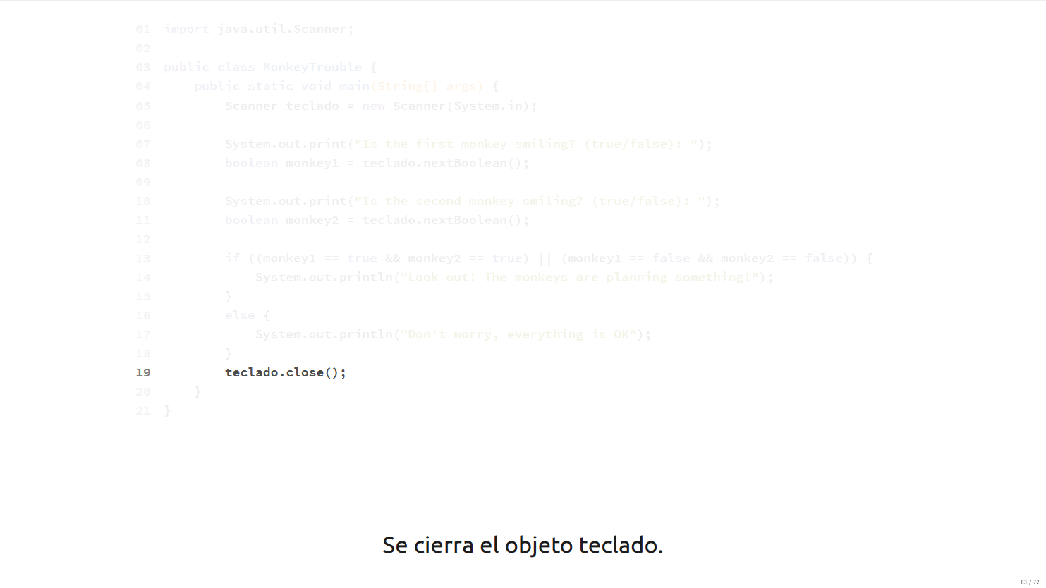

Slide 33
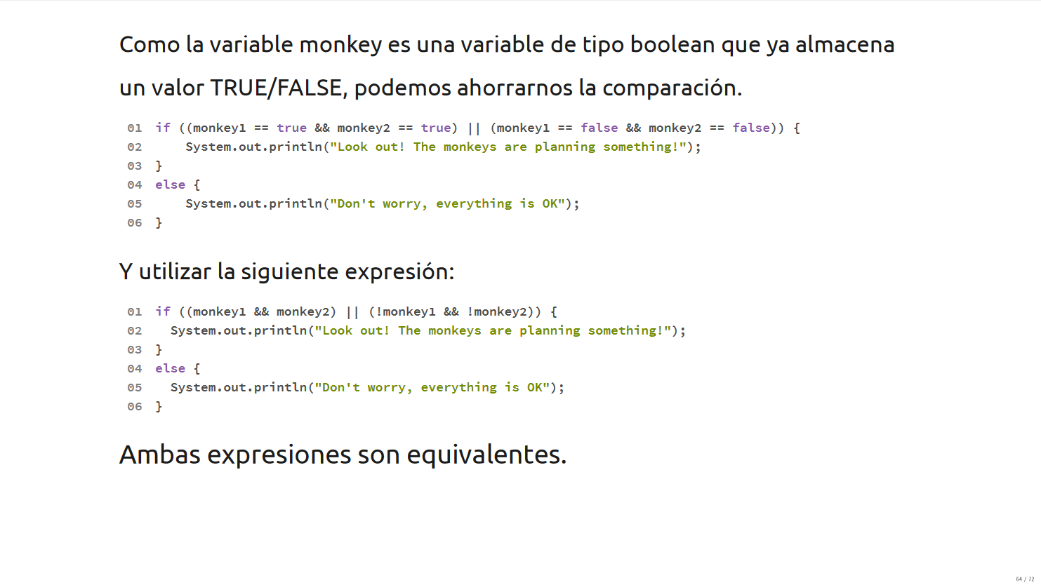

Slide 34
Switch

Slide 35




Lunes
Martes
Miércoles y Jueves
Viernes
Sábado y Domingo
No hay promociones!
$49.00
$35.00
$30.00

Slide 36
Usando IFs
Scanner keyboard = new Scanner(System.in); System.out.print("What day is today?: "); String day = keyboard.nextLine(); if (day.equals("Monday")){ System.out.println("2x1 in movie tickets!"); }
if (day.equals("Tuesday")){ System.out.println("Popcorn for $49.00"); }
if (day.equals("Wednesday") || day.equals("Thursday")){ System.out.println("Movie tickets for $35.00"); }
if (day.equals("Friday")) System.out.println("Any coffee for $30.00"); }
if (day.equals("Saturday") || day.equals("Sunday")){ System.out.println("No promos!"); } keyboard.close();

Slide 37
Usando IFs
Problemas:
El programa no detecta escenarios en donde los días están mal escritos.
Debemos agregar una condición por cada caso que debamos considerar.
Largo y difícil de leer.
Scanner keyboard = new Scanner(System.in); System.out.print("What day is today?: "); String day = keyboard.nextLine(); if (day.equals("Monday")){ System.out.println("2x1 in movie tickets!"); }
if (day.equals("Tuesday")){ System.out.println("Popcorn for $49.00"); }
if (day.equals("Wednesday") || day.equals("Thursday")){ System.out.println("Movie tickets for $35.00"); }
if (day.equals("Friday")) System.out.println("Any coffee for $30.00"); } if (day.equals("Saturday") || day.equals("Sunday")){ System.out.println("No promos!"); } keyboard.close();

Slide 38
Usando IF-ELSE
Scanner keyboard = new Scanner(System.in);
System.out.print("What day is today?: ");
String day = keyboard.nextLine();
if (day.equals("Monday")){
System.out.println("2x1 in movie tickets");
} else if (day.equals("Tuesday")){
System.out.println("Popcorn for $49.00");
} else if (day.equals("Wednesday") || day.equals("Thursday")){
System.out.println("Movie tickets for $35.00");
} else if (day.equals("Friday")){
System.out.println("Any coffee for $30.00");
} else if (day.equals("Saturday") || day.equals("Sunday")){
System.out.println("No promos :(");
} else {
System.out.println("Invalid day! try again");
}
keyboard.close();

Slide 39
Usando IF-ELSE
Problemas:
Debemos agregar una condición por cada caso que debamos considerar.
Largo y difícil de leer.
Scanner keyboard = new Scanner(System.in);
System.out.print("What day is today?: ");
String day = keyboard.nextLine();
if (day.equals("Monday")){
System.out.println("2x1 in movie tickets");
} else if (day.equals("Tuesday")){
System.out.println("Popcorn for $49.00");
} else if (day.equals("Wednesday") || day.equals("Thursday")){
System.out.println("Movie tickets for $35.00");
} else if (day.equals("Friday")){
System.out.println("Any coffee for $30.00");
} else if (day.equals("Saturday") || day.equals("Sunday")){
System.out.println("No promos :(");
} else {
System.out.println("Invalid day! try again");
}
keyboard.close();

Slide 40
Switch
Un switch es una instrucción condicional que nos permite determinar múltiples caminos a partir de una expresión integral.
Podemos utilizar una variable numérica o texto para generar los distintos caminos.
El switch está compuesto por tres elementos:
Switch
Case
Default (opcional)

Slide 41
Especificamos la condición usando:
switch(<expresion integral>)
Scanner keyboard = new Scanner(System.in);
System.out.print("What day is today?: ");
String day = keyboard.nextLine();
switch(day){
case "Monday":
System.out.println("2x1 in movie tickets");
break;
case "Tuesday":
System.out.println("Popcorn for $49.00");
break;
case "Wednesday":
System.out.println("Movie tickets for $35.00");
break;
case "Friday":
System.out.println("Any coffee for $30.00");
break;
}
keyboard.close();
Especificamos cada camino utilizando la sintaxis:
case <caso>:

Slide 42
Scanner keyboard = new Scanner(System.in);
System.out.print("What day is today?: ");
String day = keyboard.nextLine();
switch(day){
case "Monday":
System.out.println("2x1 in movie tickets");
break;
case "Tuesday":
System.out.println("Popcorn for $49.00");
break;
case "Wednesday":
System.out.println("Movie tickets for $35.00");
break;
case "Friday":
System.out.println("Any coffee for $30.00");
break;
}
keyboard.close();
La sentencia break se agrega para salir del bloque switch {}
Si no agregamos esta instrucción, el programa se saltaría a los siguientes case

Slide 43
Scanner keyboard = new Scanner(System.in);
System.out.print("What day is today?: ");
String day = keyboard.nextLine();
switch(day){
case "Monday":
System.out.println("2x1 in movie tickets");
break;
case "Tuesday":
System.out.println("Popcorn for $49.00");
break;
case "Wednesday": case "Thursday":
System.out.println("Movie tickets for $35.00");
break;
case "Friday":
System.out.println("Any coffee for $30.00");
break;
case "Saturday":
case "Sunday":
System.out.println("No promos :(");
break;
default:
System.out.println("Invalid day! try again");
}
keyboard.close();
Si queremos especificar múltiples casos con la misma lógica, podemos indicar
case <scenario1>: case <scenario2>:
case <scenario3>: code; break;
También podemos especificar un caso por default:
default:

Slide 44
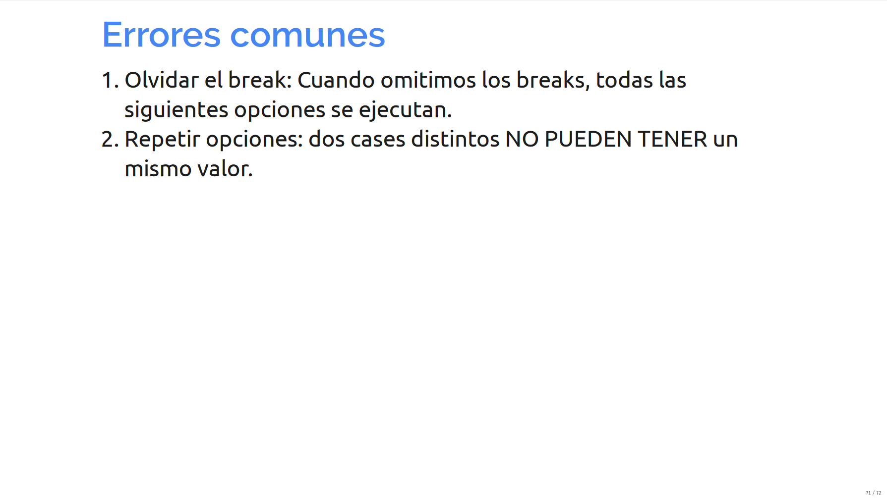

Slide 45
